Slide 2

Financial Analysis & Modelling
Using Excel functions in Personal Financial Planning
Best wishes
Dr R Narayanaswamy

Slide 3
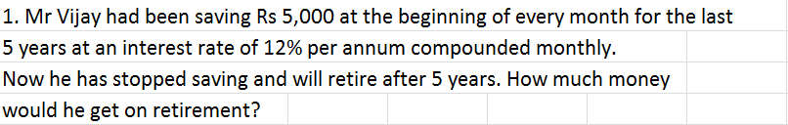



PROBLEM
+91 98452 87646 Dr R. Narayanaswamy lecswamy@gmail.com
Notes:
www.swamyspfa.blogspot.in

Slide 4
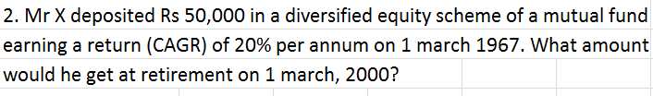

PROBLEM
+91 98452 87646 Dr R. Narayanaswamy lecswamy@gmail.com
Notes:
www.swamyspfa.blogspot.in

Slide 5
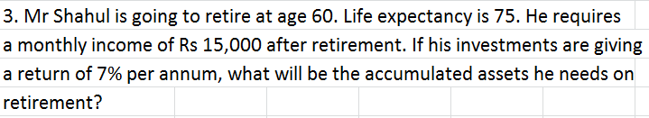


PROBLEM
+91 98452 87646 Dr R. Narayanaswamy lecswamy@gmail.com
Notes:
www.swamyspfa.blogspot.in

Slide 6
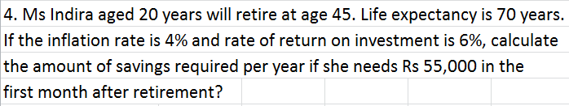



PROBLEM
+91 98452 87646 Dr R. Narayanaswamy lecswamy@gmail.com
Notes:
www.swamyspfa.blogspot.in

Slide 7
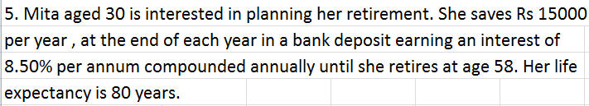
PROBLEM
+91 98452 87646 Dr R. Narayanaswamy lecswamy@gmail.com
Notes:
www.swamyspfa.blogspot.in

Slide 8
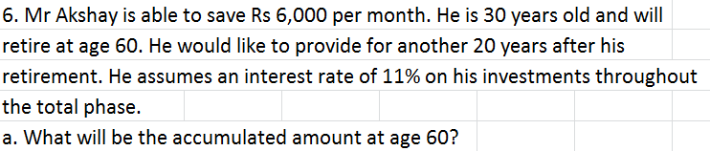



PROBLEM
Assume money required at the end.
+91 98452 87646 Dr R. Narayanaswamy lecswamy@gmail.com

Slide 9
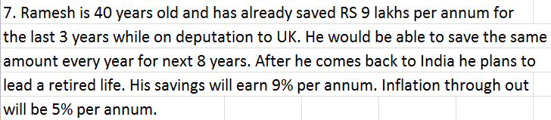

PROBLEM
+91 98452 87646 Dr R. Narayanaswamy lecswamy@gmail.com
Notes:
www.swamyspfa.blogspot.in

Slide 10



PROBLEM
+91 98452 87646 Dr R. Narayanaswamy lecswamy@gmail.com
Notes:
www.swamyspfa.blogspot.in

Slide 11
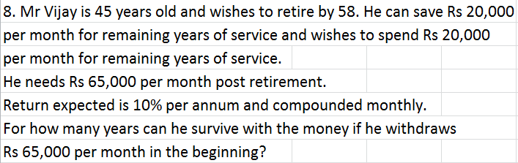


PROBLEM
+91 98452 87646 Dr R. Narayanaswamy lecswamy@gmail.com
Notes:
www.swamyspfa.blogspot.in

Slide 12
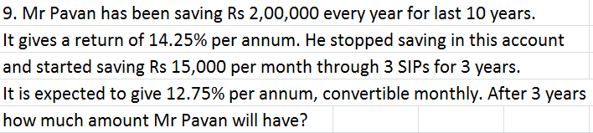




PROBLEM
+91 98452 87646 Dr R. Narayanaswamy lecswamy@gmail.com
Notes:
www.swamyspfa.blogspot.in

Slide 13
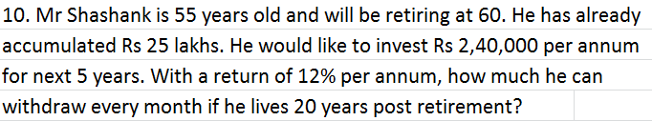

PROBLEM
+91 98452 87646 Dr R. Narayanaswamy lecswamy@gmail.com
Notes:
www.swamyspfa.blogspot.in

Slide 14
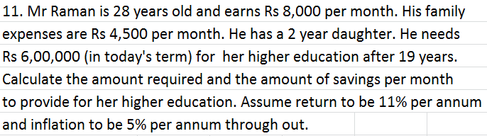


PROBLEM
+91 98452 87646 Dr R. Narayanaswamy lecswamy@gmail.com
Notes:
www.swamyspfa.blogspot.in

Slide 15
PROBLEM
12. Mr Vijay is 40 years old and spends annually Rs 7 lakhs towards his household expenses. He expects to retire at 62 years. During this period inflation is expected to be 6% p.a. He wishes to cover 35 years living expenses for self and spouse. If the inflation post retirement moderates to 4% p.a. and he expects to generate a return of 7% p.a. from his accumulated corpus, what amount he should target for a comfortable retirement?
Ans:
Annual Amount ₹ 25,22,476.19
Inflation adjusted return 2.884615385
Corpus ₹ -5,67,15,821.09
+91 98452 87646 Dr R. Narayanaswamy lecswamy@gmail.com
Notes:
www.swamyspfa.blogspot.in

Slide 16
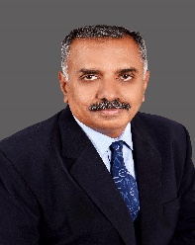
Happy Learning
Best wishes
+ 91 98452 87646 Dr R. Narayanaswamy lecswamy@gmail.com
Notes:
www.swamyspfa.blogspot.in

